Slide 1
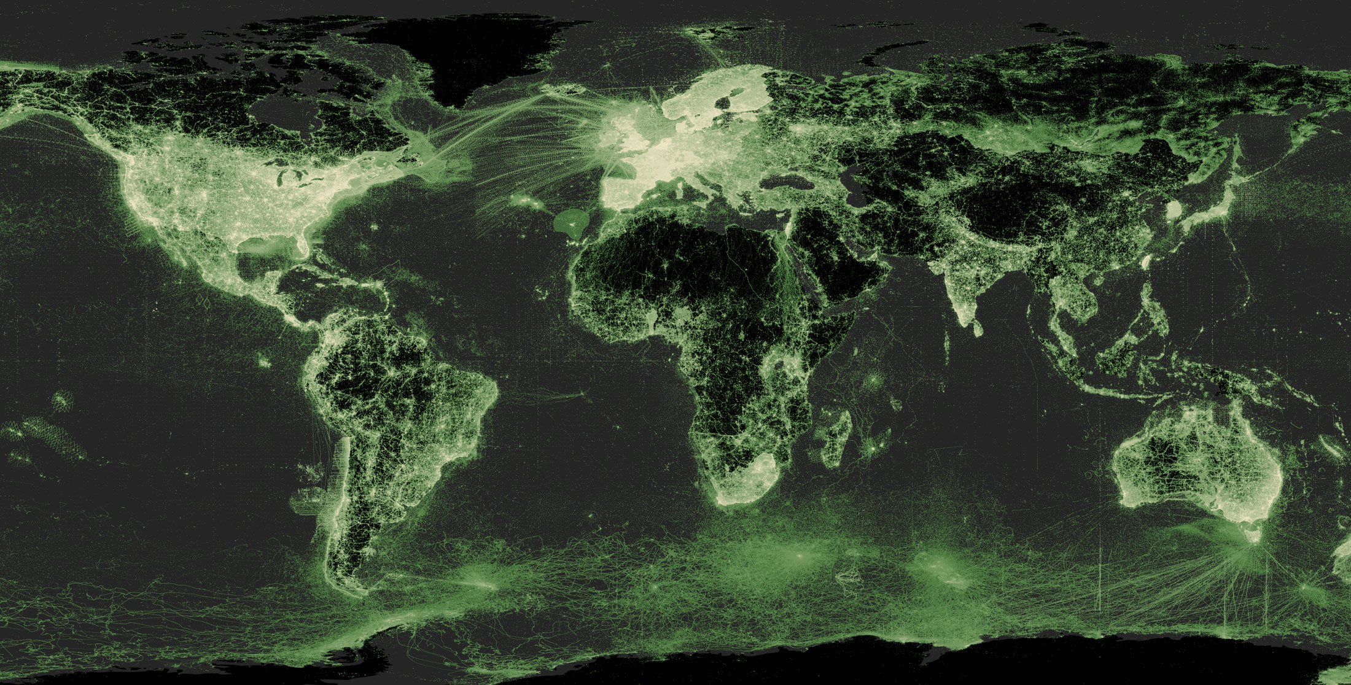
Overview slides
13 January 2026

Slide 2


Datasets
Hosted portals
119,790
58
Country Participants
Peer-review papers
using data (1 Sep 2025)
69
13,932
Organizational Participants
Average records
downloaded per month (2025)
42
297 billion
Publishers
Species
occurrence records
2,623
3,598,364,337
By the numbers | 13 January 2026
www.gbif.org

Slide 3
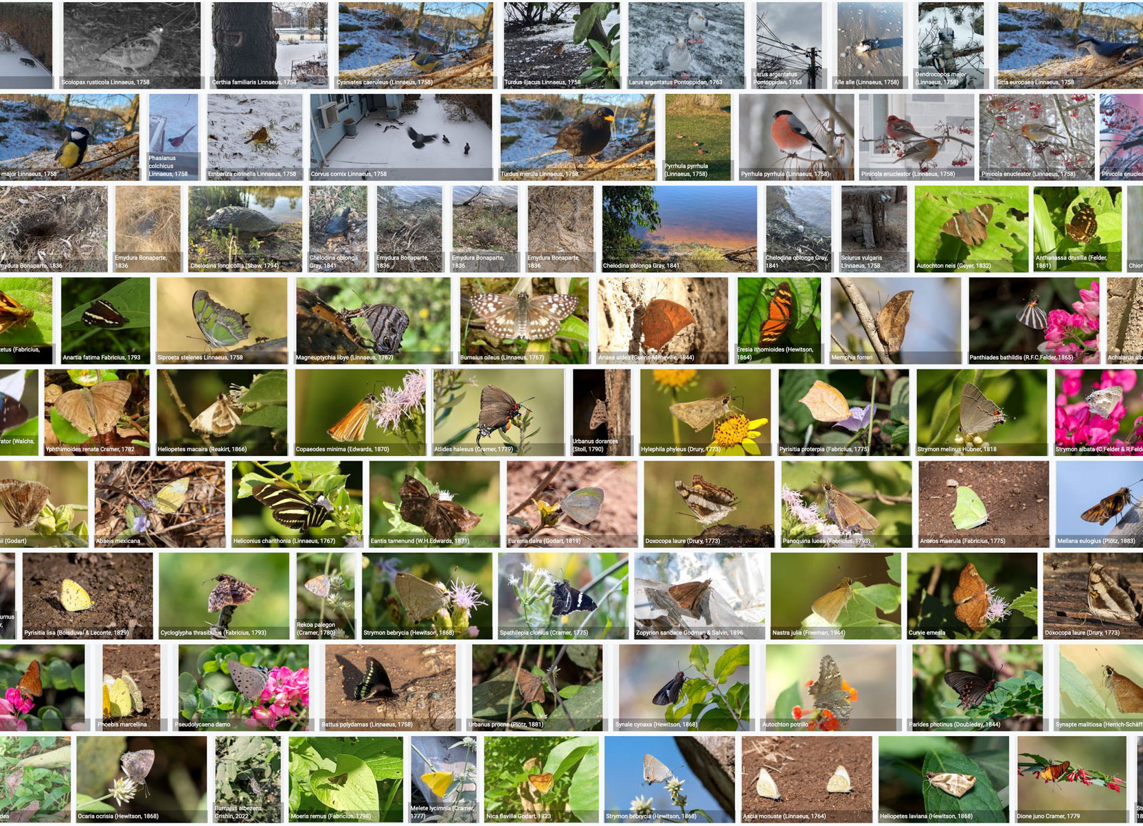
Species occurrence records with multimedia evidence
13 January 2026
267.4
million records
with taxonomically
identified images
1,849,262
audio files
5,478
videos
https://www.gbif.org/occurrence/gallery

Slide 4
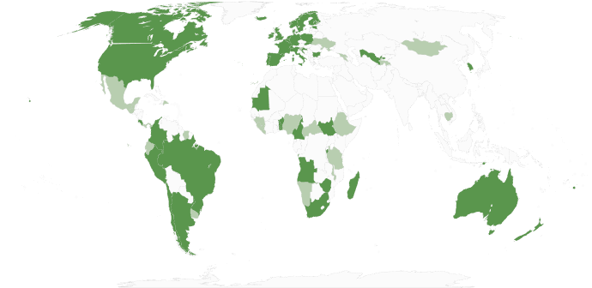
GBIF Participant countries
1 January 2026
Voting Participants
Associate Participants

Slide 5
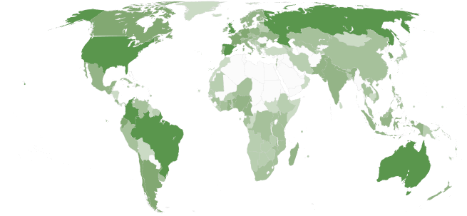
GBIF network of data publishing institutions
1 January 2026
148
countries/areas with institutions
sharing data through GBIF
Number of active publishers by country or area

Slide 6
GBIF.org traffic by country: 2025
1 January 2026
Rank | Country/Territory | Visitors | Visits | Effective visits* | % Effective visits | 2025 rank | Pages / visit
1 | United States | 13,164,386 | 15,424,793 | 1,850,975 | 9.43 % | 2 | 1.33
2 | Brazil | 7,694,514 | 8,712,776 | 348,511 | 9.26 % | 6 | 1.22
3 | India | 2,230,857 | 2,454,959 | 171,847 | 5.24 % | 10 | 1.44
4 | China | 2,009,286 | 3,740,583 | 486,276 | 4.84 % | 1 | 2.44
5 | Argentina | 935,800 | 1,072,476 | 64,349 | 4.63 % | 21 | 1.28
6 | Indonesia | 676,600 | 786,614 | 212,386 | 4.60 % | 5 | 3.41
7 | Mexico | 656,829 | 750,293 | 157,562 | 4.39 % | 9 | 2.67
8 | Singapore | 624,386 | 638,269 | 12,765 | 4.19 % | 13 | 1.18
9 | France | 614,300 | 709,566 | 227,061 | 3.42 % | 4 | 3.77
10 | Russian Federation | 610,043 | 713,214 | 99,850 | 2.19 % | 14 | 2.51
 | TOTAL | 38,585,543 | 45,911,857 | 6,427,660 | 100.00% |  | 1.97

Slide 7
Occurrences published by country: 2025
1 January 2026
Rank | Country/Territory | 2025 | 2024 total | 2024 rank
1 | United States | 203,021,107 | 158,323,230 | 1
2 | Australia | 53,466,496 | 14,003,238 | 6
3 | United Kingdom | 41,629,288 | 12,937,909 | 7
4 | Belgium | 32,755,821 | 5,800,027 | 13
5 | Canada | 32,338,096 | 22,530,126 | 5
6 | Norway | 27,575,496 | 4,061,537 | 17
7 | Germany | 23,745,033 | 3,012,732 | 22
8 | Netherlands | 21,639,084 | 25,251,708 | 4
9 | Denmark | 20,223,341 | 3,440,155 | 18
10 | Sweden | 15,314,346 | 25,696,306 | 3
OTHER COUNTRIES + AREAS | OTHER COUNTRIES + AREAS | 142,119,486 | 97,322,395
TOTAL |  | 613,827,594 | 428,451,251

Slide 8
Data download requests by country: 2025
1 January 2026
Rank | Country |  | 2025 | 2024 total | 2024 rank
1 | China | 65,697 |  | 63,485 | 1
2 | United States | 50,845 |  | 41,921 | 2
3 | Mexico | 27,758 |  | 29,712 | 3
4 | Colombia | 22,565 |  | 21,247 | 5
5 | United Kingdom | 20,018 |  | 21,641 | 7
6 | Brazil | 18,988 |  | 14,704 | 4
7 | Spain | 15,230 |  | 13,502 | 6
8 | Germany | 10,991 |  | 8,558 | 10
9 | France | 10,142 |  | 7,248 | 9
10 | Canada | 9,678 |  | 8,946 | 8
OTHER COUNTRIES + AREAS | ALL OTHERS | 145,074 |  | 115,002
TOTAL |  | 396,986 |  | 347,717
174
countries, islands & territories where users have ≥5 requested downloads in 2025
Notes:
DOWNLOAD ADJUSTMENTS FOR USERS ≥500 DOWNLOADS FOR JAN-SEPT 2025: AT (1) 2084; AU (1): 961; BE (2): 1440; BR (7): 14717; CA (2): 1358; CH (2): 2474; CN (18): 33554; CZ (2): 2308; DE (4): 2552 ; DK (2): 5583; ES (3): 4034; FR (2): 1597; GB (15): 171162; HR (1): 1977; IL (2) 4302; IN (1): 667; IT (3): 3047; JP (2) 4676; KR (2): 8477; MO (1): 2163; MX (3): 7919; NL (3): 7755; PT (2): 1508; RO (1): 559; TH (1): 1583; TW (1) 2947; US (18): 42321; ZA (2): 31504

Slide 9
Peer-reviewed publications using GBIF-mediated data
1 September 2025

Slide 10
Data use in peer-reviewed journals: 2025
1 September 2025
Peer-reviewed uses by country
Peer-reviewed uses by region
End of Year |  |  | 2025 total | 2024 total | 2024 rank
1 | China |  | 523 | 529 | 1
2 | United States |  | 358 | 486 | 2
3 | Brazil |  | 166 | 238 | 3
4 | United Kingdom |  | 152 | 186 | 5
5 | Germany |  | 131 | 186 | 6
6 | Spain |  | 112 | 171 | 7
7 | Mexico |  | 90 | 186 | 4
8 | Canada |  | 87 | 100 | 11
9 | Australia |  | 82 | 104 | 10
10 | India |  | 73 | 78 | 12

Slide 11


Suggestions reviewed
Institutions
8,915
3,088
vv
Countries
Collections
128
10,602
Country editors
Digitized specimens
69
264,745,092
GRSciColl by the numbers | 13 January 2026
scientific-collections.gbif.org
Notes:
Our community of editors is doing a huge work to update GRSciColl. In 2024 alone, more than 1600 entries were added to GRSciColl. At the core of the GRSciColl work are our Nodes and the GBIF Regional support teams which have been working on reaching out to institutions in GRSciColl as an entry point to sharing GBIF data.

Slide 12




Hosted portals update
13
GBIF national Participants and regions
9
Institutional
58
Hosted portals in production
9
27
Networks/thematic networks
Scientific journal

Slide 13
Metabarcoding data programme
51
57,376,184
20
Datasets
Records
Installations
gbif.org/metabarcoding
Notes:
Notes

Slide 14
Social media
1 January 2026
FOLLOWERS
17,224
13,035
1,850
2,724
POSTS
298
16,091
293
11,449
355
1,927
317
3,259
ENGAGEMENTS

Slide 15
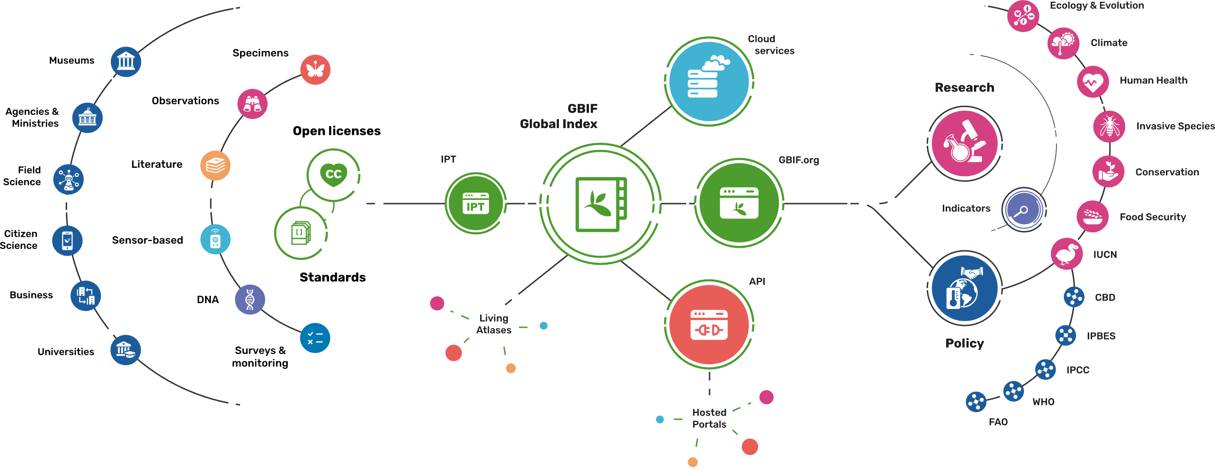
Providing biodiversity evidence for research and policy

Slide 16
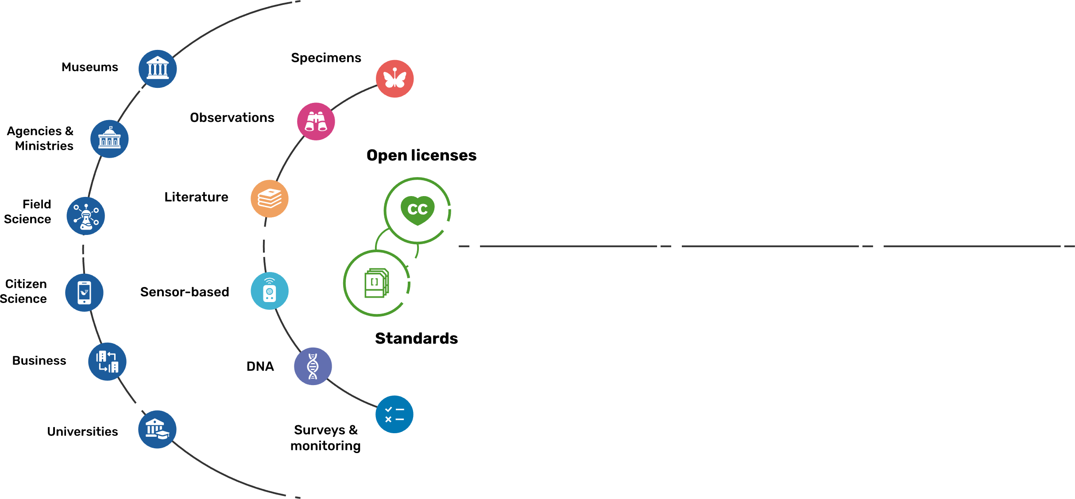
Sources of biodiversity evidence
Create
Combine sources of evidence

Slide 17
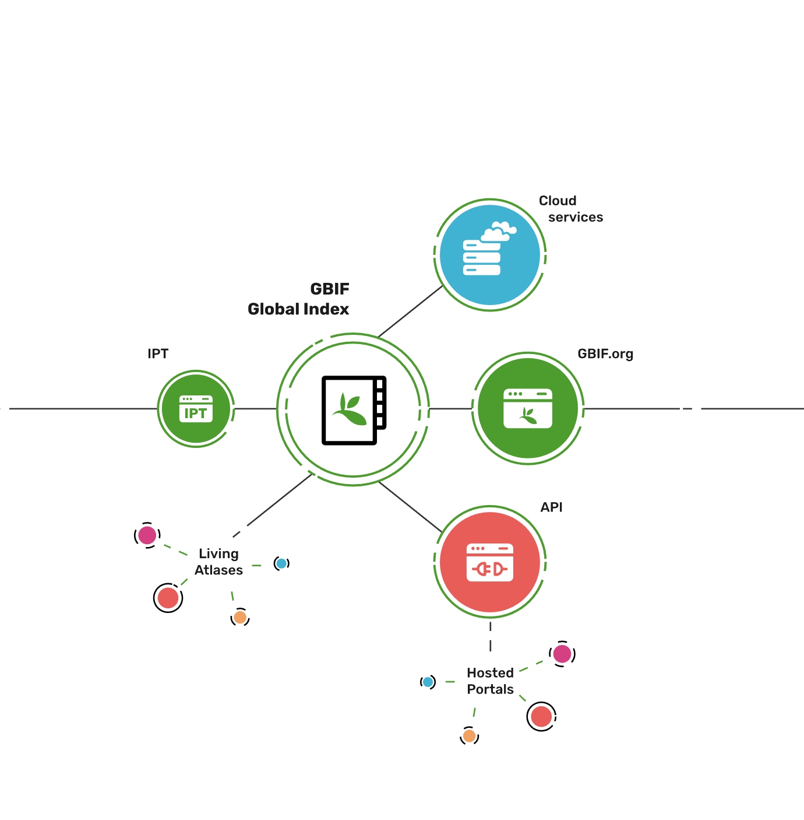
Access to biodiversity evidence
Share
FAIR and open access

Slide 18
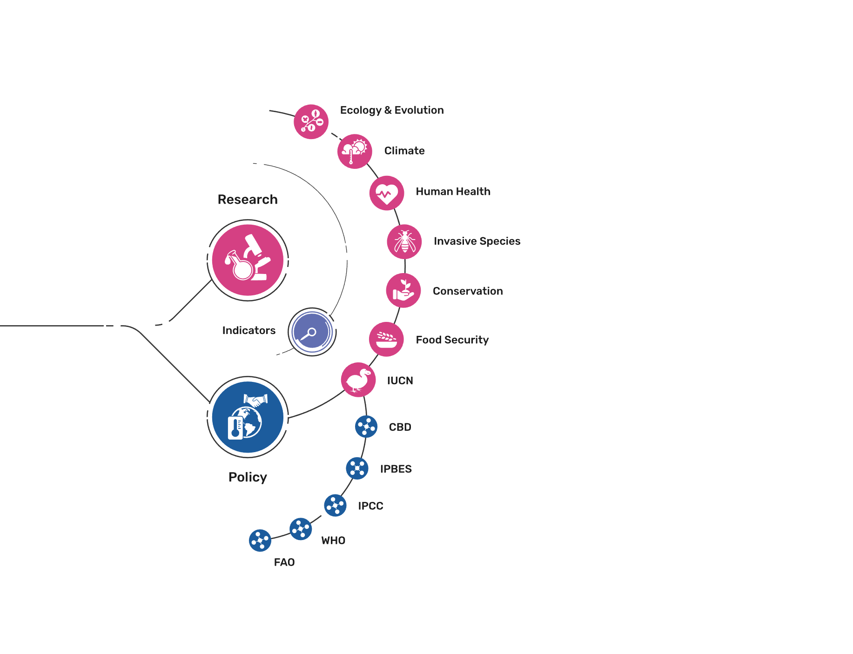
Uses of biodiversity evidence
Transform
Apply and use data

